Slide 1
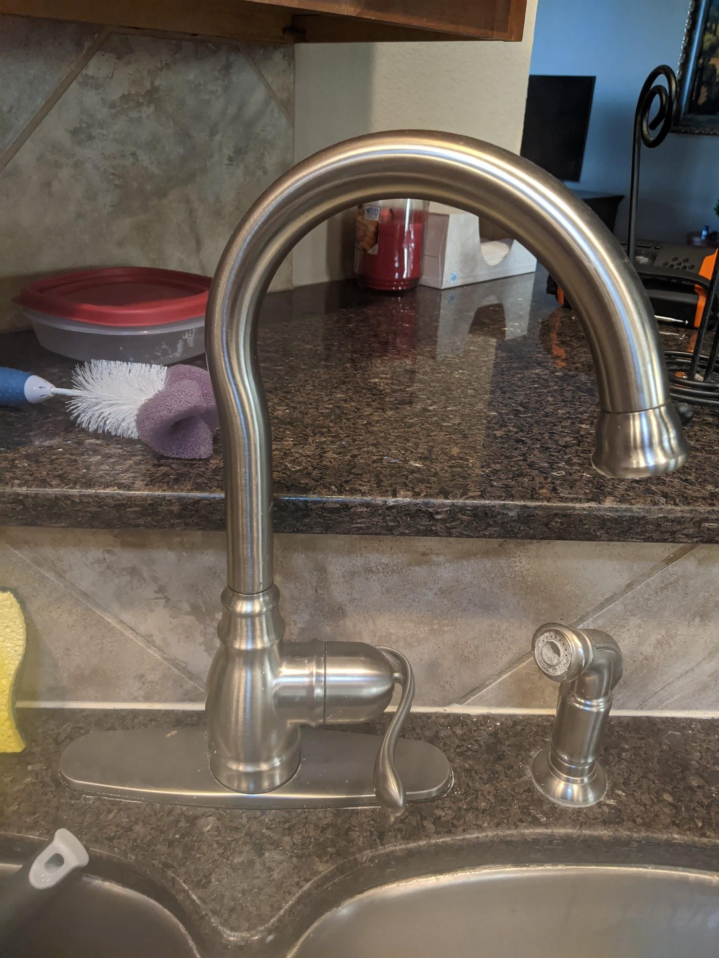
Design Issues with my Faucet

Slide 2
Background
This faucet has been in my house from when we built in roughly 12 years ago.
It is a Delta kitchen faucet but because it is so old it is hard to tell when model it is.
This faucet does have great feedback given to the user once its turned on.

Slide 3
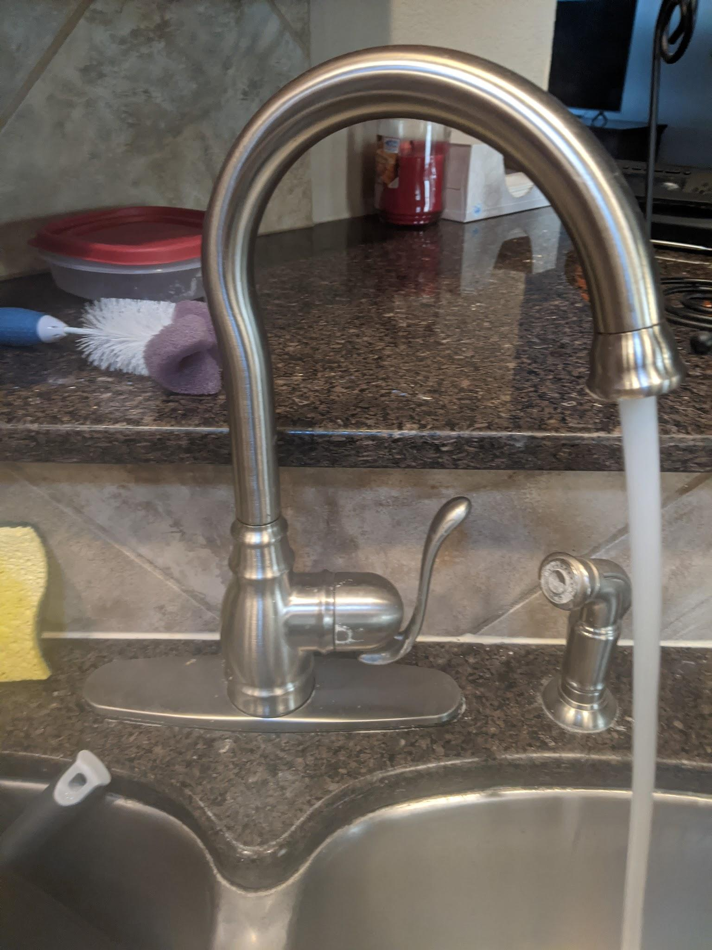
How do you turn it on?
Do you pull the handle up?
Do you pull the handle out?
The issue is that there are not any signifiers that show how to turn the water on.
Most design intuition says that in order to turn on a faucet you either twist a knob or you pull up on a lever.
In order to turn on this faucet you will need to pull out on the handle.

Slide 4
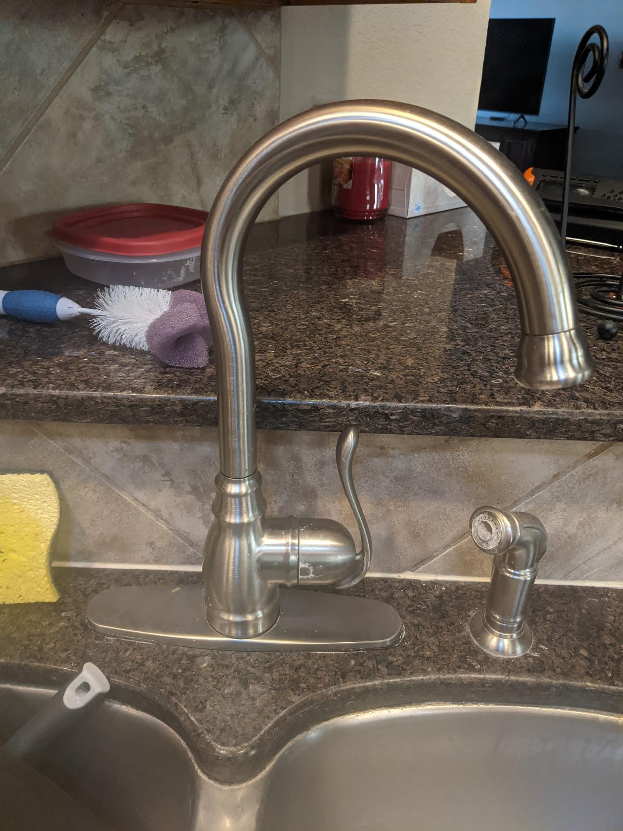
How do you get hot or cold water?
The other issue was that there is no mapping for the hot or cold water.
Do you put the faucet in the up or down position for cold water?

Slide 5
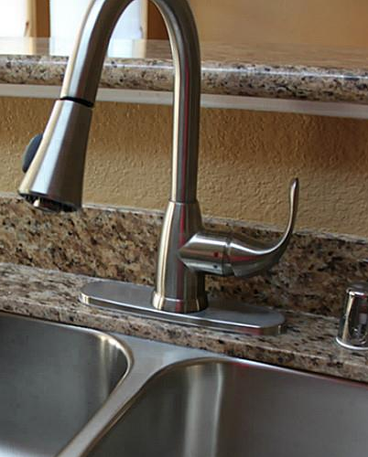
How to fix the hot and cold water issue.
The best way to fix the issue is to use a signifier or mapping to show how to use the hot and cold water.
To fix the issue you can add two colored dots.
A red dot for the hot water and a blue dot for the cold water.
This would allow the user to see what position is needed for the hot or cold water.

Slide 6
How to fix the turning on problem.
To fix the issue with of how do you turn on the water. It would also be accomplished by adding the hot and cold indicators. Where once you move the handle to the position needed the only other thing you can do is to pull out on the handle.

